Slide 1
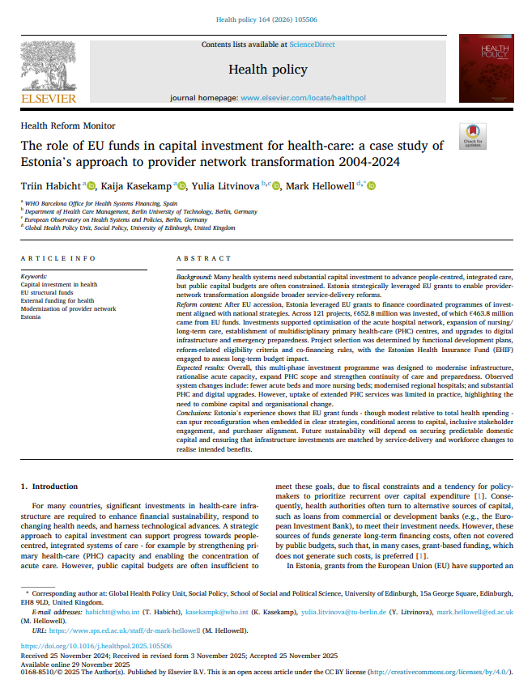


Lessons learned - Linking EU funding tools with national priorities
Experiences from Estonia
Capacity Building Workshop for EU instruments

Slide 2
EU funding instruments for health infrastructure
European Regional Development Fund (ERDF) (2004–2020)
Hospital network optimisation and consolidation
Expansion of long-term care (inpatient nursing) capacity
Development of multidisciplinary PHC centres
REACT-EU (2020–2023) Emergency preparedness
Isolation wards, oxygen capacity
Infrastructure resilience (power supply, continuity of care)
Recovery and Resilience Facility (RRF) (2020–2026)
Integrated hospital-PHC infrastructure
In total €652.8 million total investment, of which €463.8 million EU funds
(Equivalent to ~2.2% of cumulative health insurance health service spending)

Slide 3
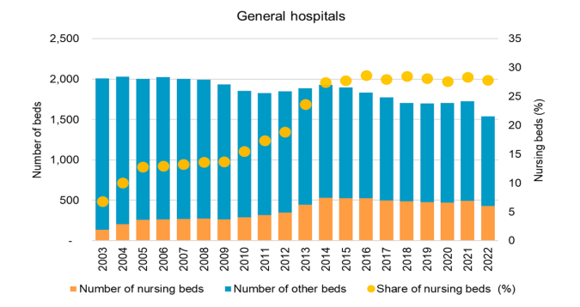
Long term care investments
How funds were used:
Repurposing a part of small acute hospitals capacity into long term care services
Expansion of inpatient nursing beds
County-level funding envelopes to ensure regional equity
Alignment with the Nursing Care Network Development Plan
Estonian Health Insurance Fund aligned purchasing strategy (increased budget allocation, contracting, payment design)
Impact:
Fewer beds in total, more nursing care beds in general hospitals
Made structural reform politically feasible by offering a “soft landing” for small hospitals

Slide 4
Primary health care investments
How funds were used:
Construction and renovation of multidisciplinary PHC centres
Alignment with the Health Care Development Plan 2020
Eligibility linked to:
Group practices (≥3-6 family doctors)
Geographic need (pre-defined service catchment areas) and population Use of municipalities and hospitals as infrastructure owners where PHC providers lacked capital
Investment in PHC IT systems
Estonian Health Insurance Fund aligned contracting and payment incentives
Impact:
Modernised physical and digital PHC infrastructure (54 centres + integrated hospital-PHC site)
Enabled group practices and better working conditions
Reduced infrastructure inequality between regions
By autumn 2022, 36 % of EU funded PHC practices had not signed contracts to extend their scope of services -> infrastructure ≠ service change

Slide 5

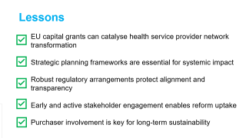
Lessons
EU capital grants can catalyse health service provider network transformation
Strategic planning frameworks are essential for systemic impact
Robust regulatory arrangements protect alignment and transparency
Early and active stakeholder engagement enables reform uptake
Purchaser involvement is key for long-term sustainability

Slide 6
Thank you!

