Slide 1


Strategic Workforce Enhancement & Investment: Technical Support Instrument: Reference documents
Madrid 30 January 2026

Slide 3
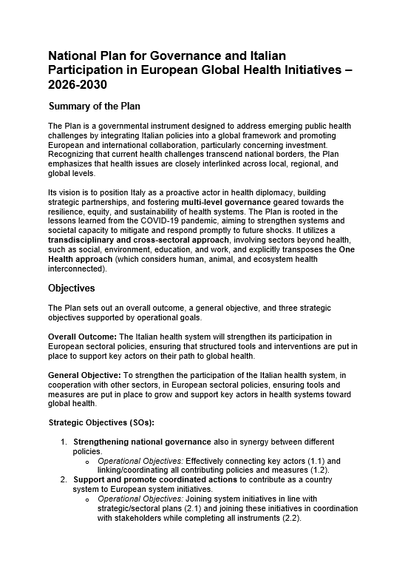
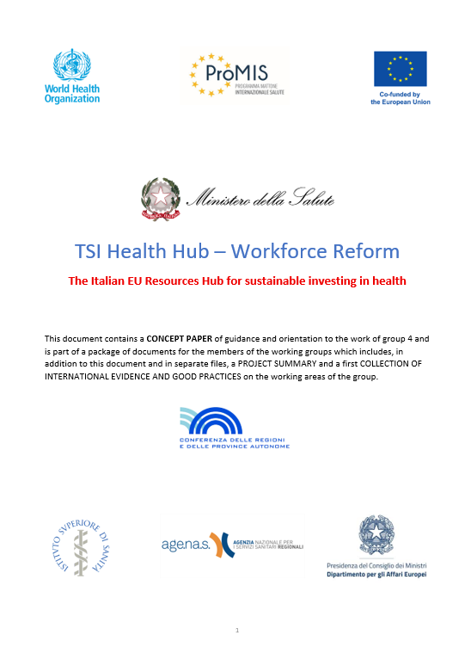
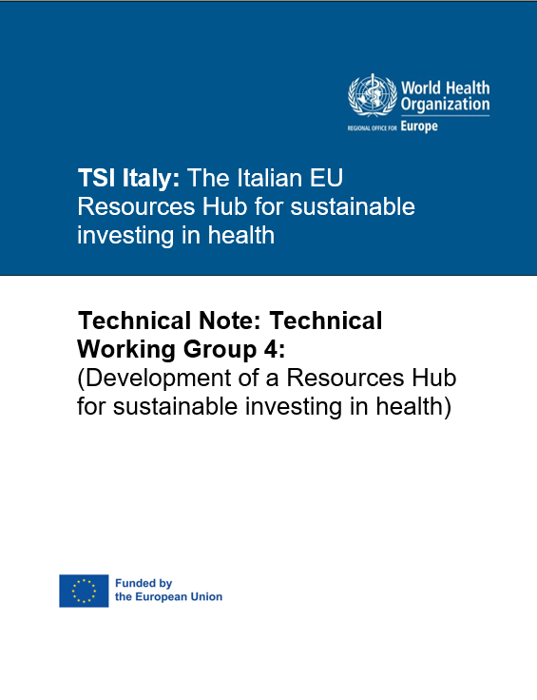
Key reading -> to start

Slide 4
National Plan: Purpose & Vision
Positions Italy as a proactive European and global health actor
Built on One Health, Health in All Policies, and system resilience
Focuses on equity, sustainability, preparedness, and skills
Lessons from COVID-19 translated into permanent governance capacity

Slide 5
National Plan: Core Governance Architecture
Strong central governance led by Ministry of Health
Cabina di Regia for planning, monitoring, and accountability
ProMIS-led technical coordination across State–Regions
Emphasis on coherence across health, labour, education, research

Slide 6
National Plan: Strategic Objectives
Strengthen national governance and policy coherence
Enable coordinated Italian participation in EU initiatives
Increase Italian contribution to EU and international organisations
Use structured tools, co-programming, and technical liaison

Slide 7
TWG 4 Concept: What It Delivers
Health Investment Hub for EU and national funds
Governance plan for sustainable health workforce investment
Roadmap for complementarity of EU, national, regional funding
Focus on digital skills, workforce reform, and long-term value

Slide 8
How TWG 4 Fits the National Plan
Operational arm of the National Plan’s governance vision
Translates policy coherence into concrete investment decisions
Provides tools for co-programming and fund alignment
Anchors workforce reform within EU strategies and One Health

Slide 9
From Opportunity to Impact
Europe does not lack money for health reform
It lacks the capacity to turn opportunity into change
Fragmentation weakens impact
Governance is the intervention

Slide 10
What We Learn
Funding follows capability, not ambition
Fragmented systems struggle to absorb investment
Preparation matters as much as infrastructure
Workforce capability is system resilience

Slide 11
Why This Matters
Governance is the intervention
Investment follows purpose, not projects
Workforce resilience is system resilience
Europe works when national systems are ready

Slide 12
What the Evidence Tells Us
Austria: investment needs continuous guidance
Belgium: learn first, build second
Slovenia: infrastructure, skills, and coordination must move together
Reform fails when people are an afterthought
TSI is a small proportion of EU and Italian investment in the Health; can catalyse wider reforms

Slide 13

What TWG 4 Must Take Forward
Think about a national entry point for health investment
Capacity building as a permanent function
Focus on what is feasible, not theoretical
Blend funds around reform, not projects
Invest early in people and preparation
Embed technical support in system governance

Slide 14
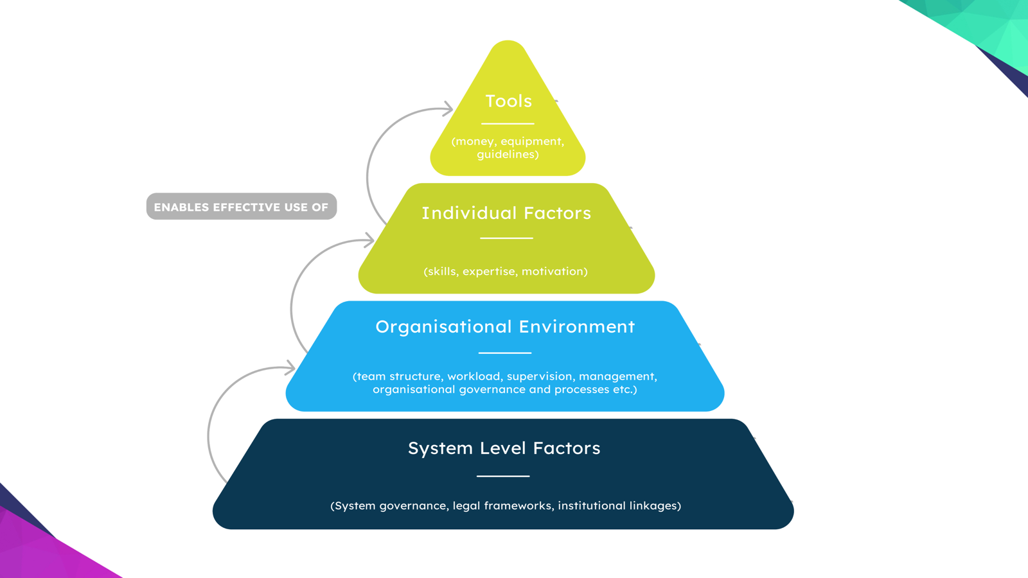

Slide 15
Grazie Mille!

