Slide 1

EU funding tools for health systems:
State of play & future outlook
Dimitra Panteli & Nicole Mauer
ES-IT Cluster meeting & Capacity Building Workshop, 29.-30.01.2026

Slide 2
The Observatory is…
A WHO hosted partnership building bridges between policy makers and research and across countries
A collection of Member States, EU, decision makers, academics & health system actors who are focused on generating and communicating evidence for policy
A project that delivers for countries through its 4 functions:
Country monitoring
Policy analysis
Health systems performance assessment and
Knowledge brokering
A resource for planners, policy and decision makers

Slide 3
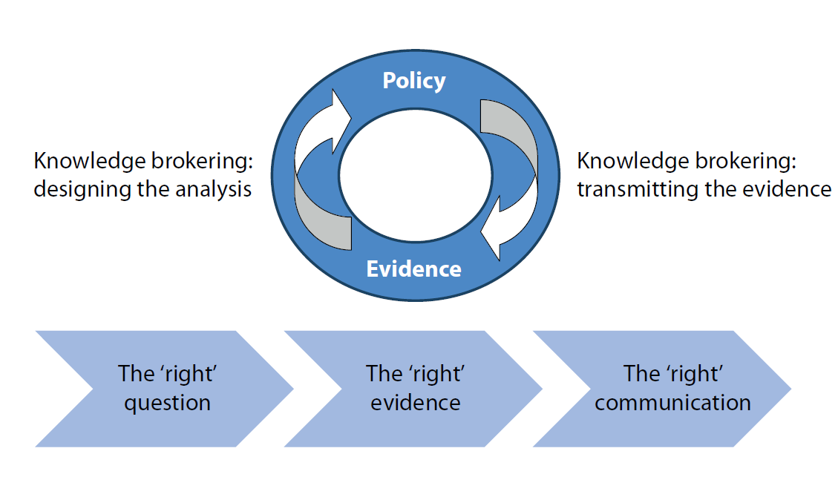
The OBS model of supporting decision makers and tailoring evidence outputs

Slide 4

Policy Brief: How can we capitalise on EU tools?
2021 Slovenian Presidency: mapping of European Union support for improving health and care systems
Though health systems are primarily the responsibility of Member States, the EU provides an increasingly shared context
A wide range of EU tools related to health systems have grown up over time
Not always clear what is available and how to access
How can these tools be combined effectively?

Slide 5

European support along the process of change
Ideas
What are the overall policy aims?
Good practice elsewhere?
Plans
Detailed options for implementation
Who and how: Stakeholders, financing, evaluation
Tests
Pilots, small-scale tests
Implementation
Large-scale system change in practice

Slide 6
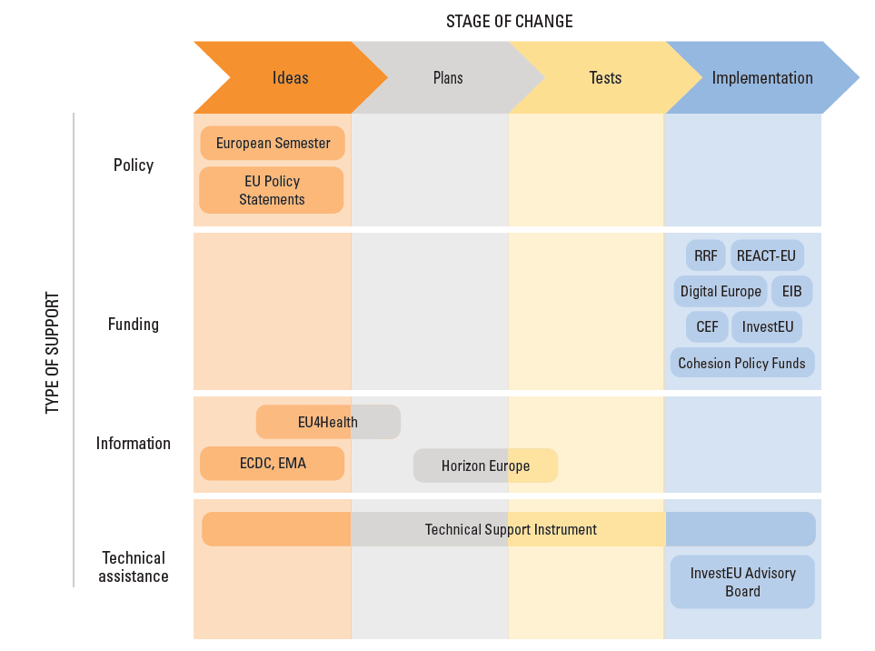
Many instruments, different uses and objectives
Which types of support does the EU provide?
Which stage can each instrument help with?

Slide 7
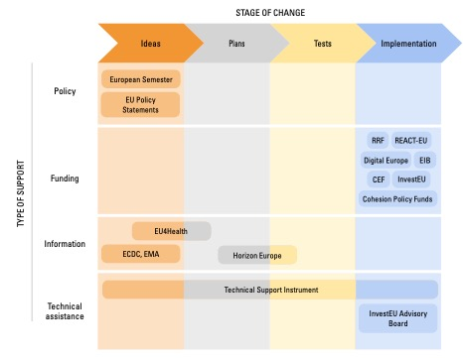
Policy: Providing direction
Country-specific recommendations within the European Semester
Recommendations for health systems have become central
Linkage to Recovery and Resilience Facility
EU policy statements for coordinated health action
Commission Communications
European Health Union
Council Recommendations and Conclusions

Slide 8
Funding: New infrastructure for health systems
Cohesion funds
Infrastructure (including technology and medical equipment), skills and training, health promotion
European Investment Bank
Low-cost loans
Large infrastructure (hospitals), but also Primary Health Care (e.g.: Austria, Ireland)
Recovery and Resilience Facility
Temporary additional boost to recovery after Covid
Health is one of six priority pillars
Use shaped by national plans, several incorporating health (e.g.: Germany, Italy, France, Austria)

Slide 9
Information: Evidence for action
EU4Health
Widest range of health-relevant activities
Cross-country evidence, best practices, cooperation, models for implementation, expert advice
Horizon Europe
Focus on technological innovation
Emerging research on health systems
EU agencies
ECDC, EMA
Expert advice and scientific evidence

Slide 10
Technical assistance: Adapting to the national context
Technical Support Instrument
Expert support across all stages of change
Potential to implement country-specific recommendations from European Semester, Recovery and Resilience Facility
InvestEU Advisory Hub
Technical assistance to plan, develop and implement investment projects drawing on EU funds

Slide 11
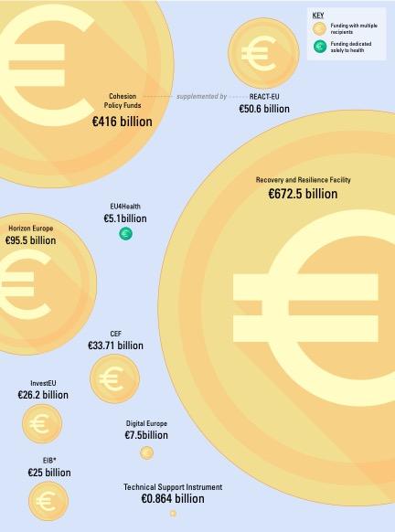
Maximising EU support requires combining tools
Comparative size of different EU funding tools:
EU4Health is the only tool dedicated exclusively to health

Slide 12







TSI 2022 – 2024: Resources hub for sustainable investment in health
A multistakeholder project with two workstreams
Work stream 1: Making the case for public investment in health
Work stream 2: ‘One-stop-shop’ EU Health Resources Hub
Austria: Greening health care facilities
Belgium: Implementing population health management for integrated care
Slovenia: Strengthening primary health care through a telephone triage system
Belgian Core Team
European Team
Austrian
Core Team
Slovenian Core Team
Adapted from Knoll & Fornaroli, 2024

Slide 13
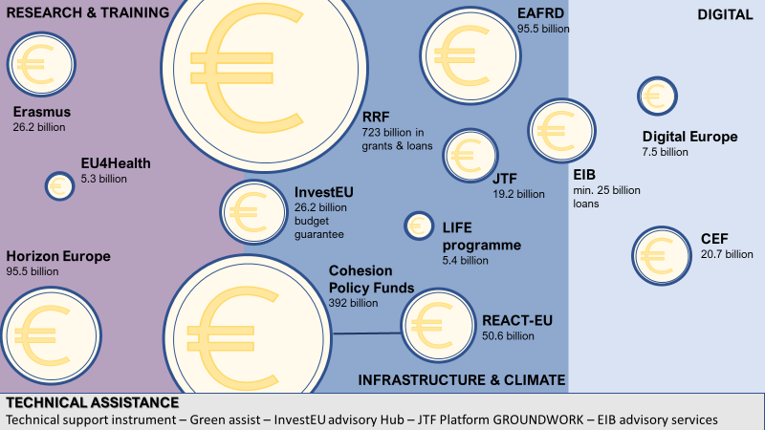

WS 2: EU resources for investing in and strengthening health systems
Notes:
https://eurohealthobservatory.who.int/publications/m/eu-resources-for-investing-in-and-strengthening-health-systems-tailored-options-for-austria-belgium-and-slovenia

Slide 14
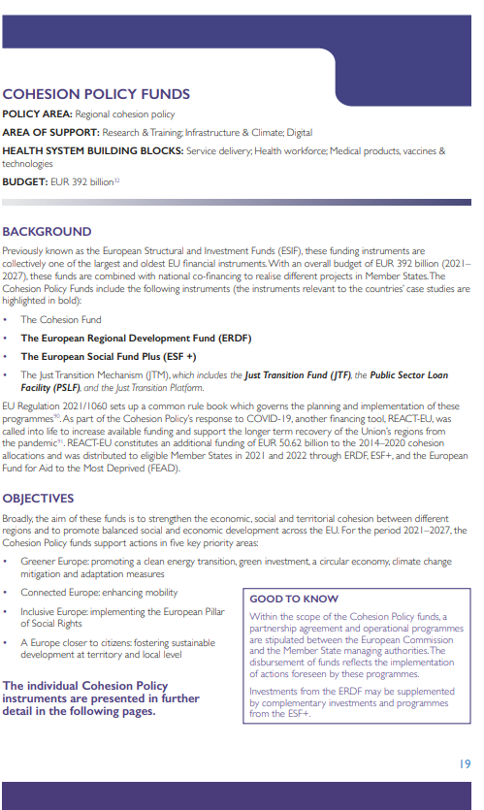
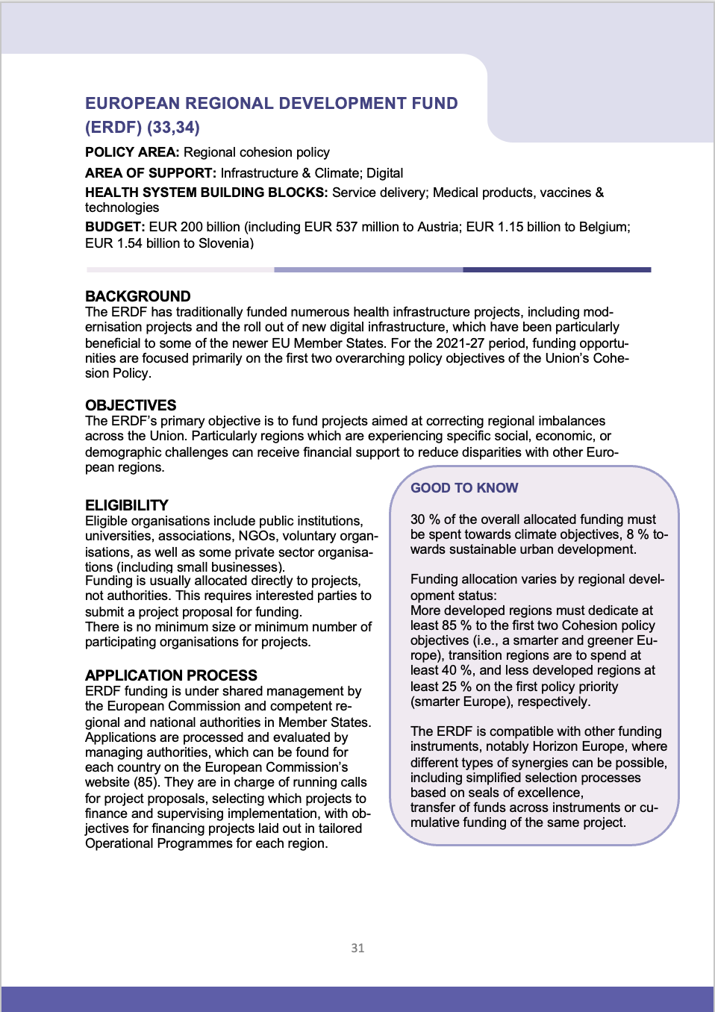
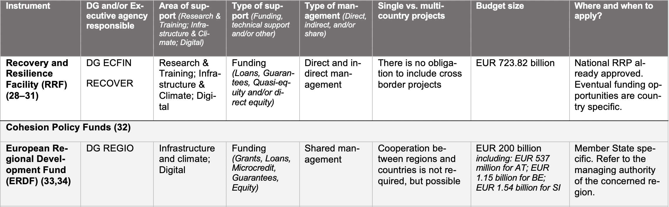
Building a hands-on catalogue of instruments

Slide 15
Different types of management, different rules
Direct management:
Project cycle (from calls for proposals to selection & evaluation) managed directly by EC & exec agencies
Applications via the Funding & Tenders Portal
Shared management:
Implementation through national/regional authorities (incl. calls for proposals, project selection, payment etc.)
Oversight through EC

Slide 16
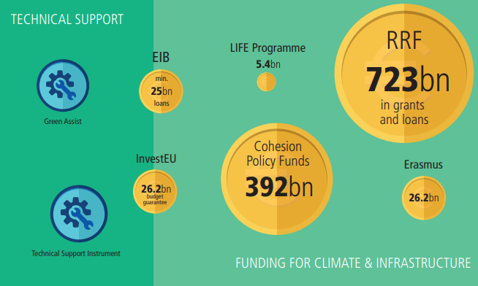

EU instruments relevant for Austria’s greening needs

Slide 17
The EU has many instruments that can potentially support health systems
Challenge of aligning different objectives of tools with the needs and interests of different health systems
Challenge of matching programme timeframes, application and eligibility criteria with these needs and to translate them into project applications
Applications are time- and resource-intensive, often requiring specialised knowledge of EU funding procedures and documentation requirements
There is scope for making process of identifying, using and combining tools easier to navigate for policy-makers

Slide 18
Looking ahead: How will the funding landscape change?

Slide 19
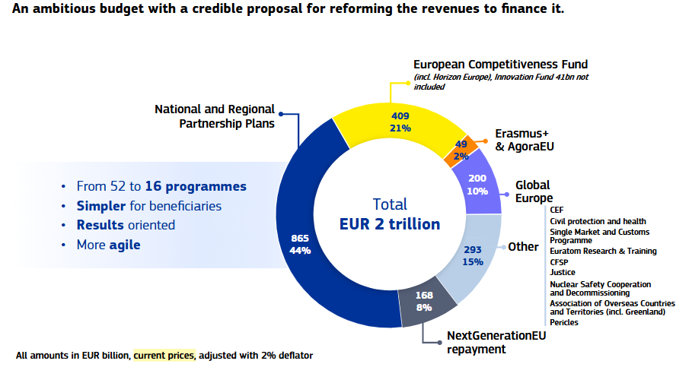
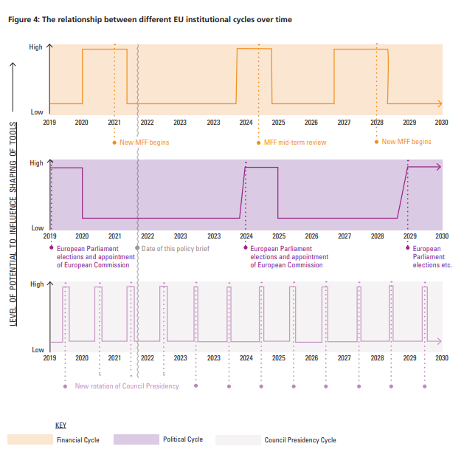
Discussions on the new MFF and a proposed Competitiveness Fund are underway
Source: https://commission.europa.eu/strategy-and-policy/eu-budget/long-term-eu-budget/eu-budget-2028-2034_en

Slide 20
Strategic direction & priorities: future outlook
European Health Union
EU Global Health Strategy
EU Beating Cancer Plan
European Health Data Space Revision of EU pharma legislation
HTA regulation
EU Safe Hearts Plan
Union prevention, preparedness and response plan for health crises
Proposal for a European biotech act
Proposed ECF window for “Health, biotech, agriculture & bioeconomy”

Slide 21
Early considerations for the new MFF
Changes may have important implications for health systems, but extent is difficult to foresee as:
Different funding instruments tend to fund different types of initiatives along the stages of change (e.g., EU4Health: evidence for action vs. ERDF: infrastructure)
There are important differences in budgetary size and other characteristics (e.g., RRF and Cohesion Policy Funds offer comparatively larger share of funding for health)
Funding instruments may substantially change – but the expertise and capacity needed to use them may not
Proposals focus on simplifying and streamlining processes – but how will access to funds work in practice?

Slide 22
THANK YOU

