Slide 1

Health
Architecture, funding and key debates
EU Multiannual Financial Framework 2028–2034
Enrique Terol
Representation of Spain to the EU
Notes:
Purpose of the presentation:
- Explain how MFF 2028–2034 impacts health even if there is no dedicated health programme.
- Framing the debate from the perspective of the Spanish Ministry of Health.
Anticipate risks and opportunities for the Spanish position.
Initial key message: health does not disappear from the MFF, but it radically changes its governance.

Slide 2
General context of MFF 2028–2034
New structured and social context
Security, competitiveness and resilience
Deep budget redesign
Health is integrated in a transversal way
Notes:
The new MFF responds to a context of multiple crises: COVID-19, war in Ukraine, tension tensions, global industrial competition and pressure on health systems.
For Health, this tactic that the EU prioritises security, resilience and competitiveness, and relegates classical public health to cross-cutting instruments.
It should be consistent that this change is not technical but political.

Slide 3
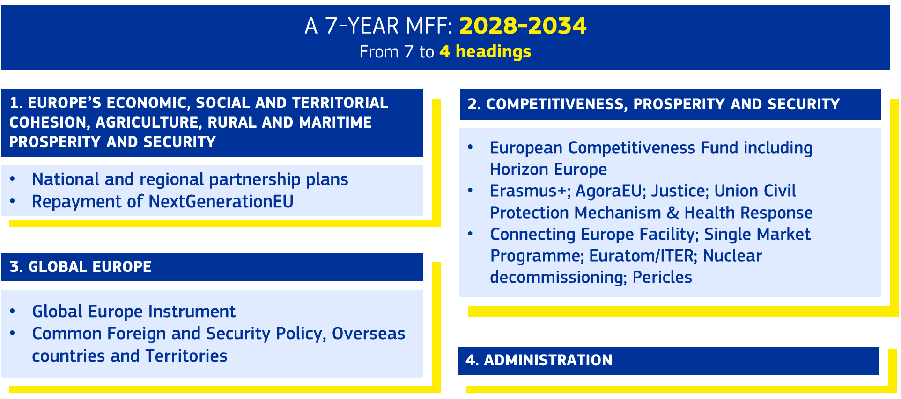
Architecture of the new MFF
health
Notes:
The architecture in 4 headings reduces political visibility of specific social policies.
Fewer programs means more internal competition for resources.
For Spain, this requires coordinating positions between Health, Finance and Science from the beginning.
Flexibility benefits crises, but it can penalise structural policies as prevention.
[Technical detail] These headings replace the more fragmented structure of the MFF 2021–2027. Health is mainly divided between Headings 1 and 2, with an external dimension in Global Europe.

Slide 4
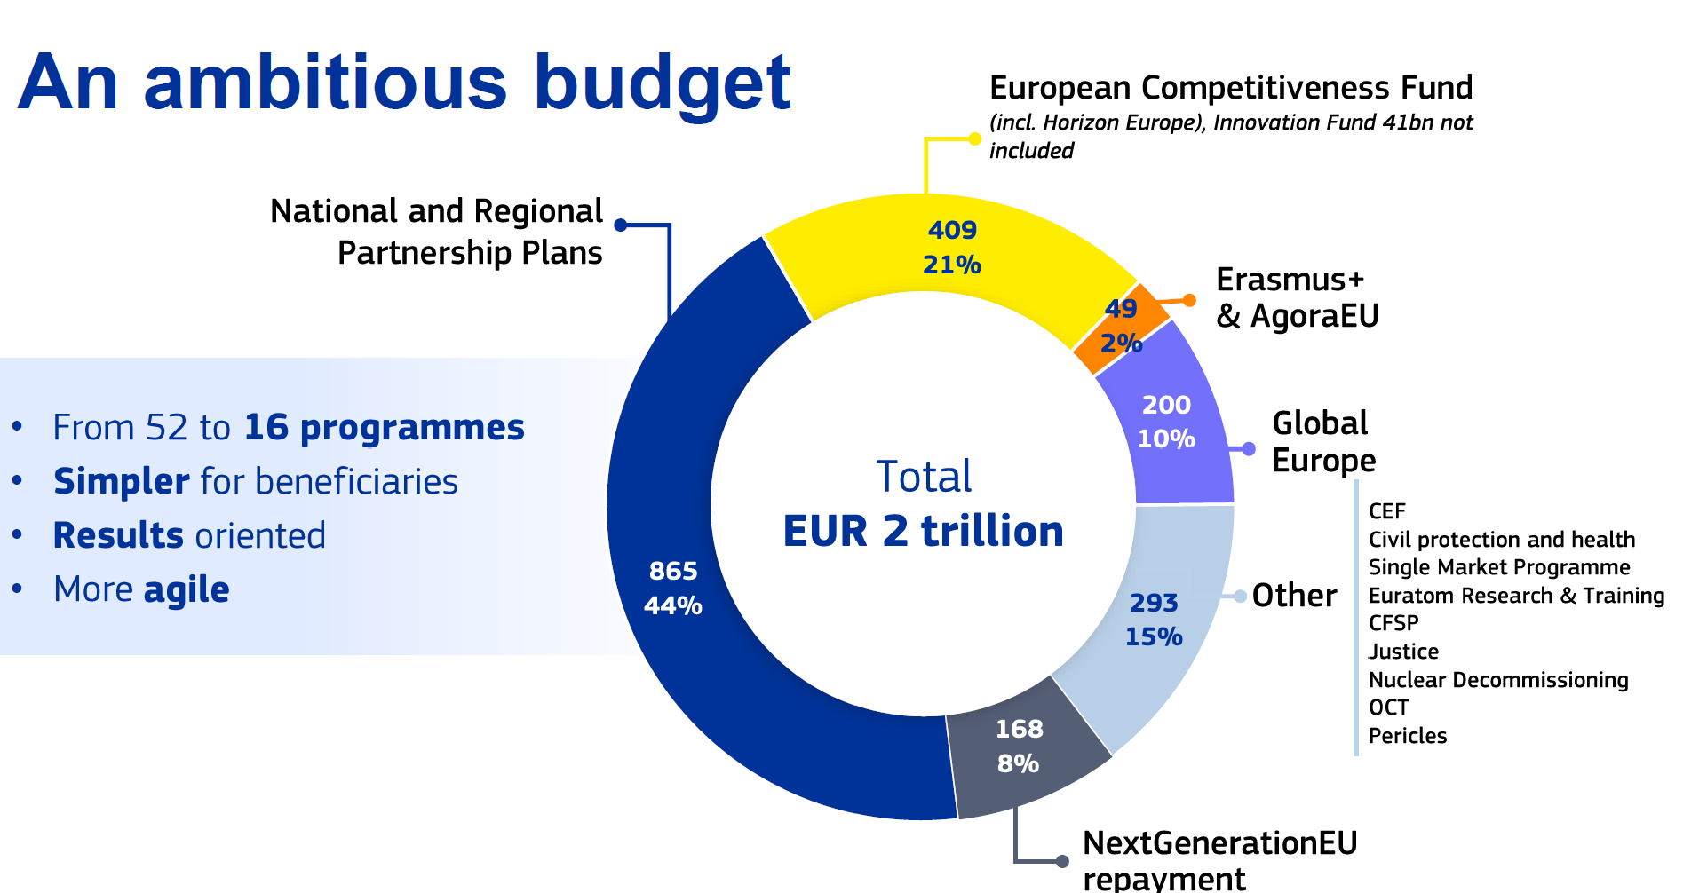

Slide 5

Where's health in the MFF?
Health is integrated through several programs and instruments:
European Competitiveness Fund – window Health, Biotech & Bioeconomy
Horizon Europe (health research and innovation)
UCPM + Health Emergency Preparedness and Response (HER)
National and Regional Partnership Plans (ERDF, ESF+)
Global Europe (global health and health systems)
There is no single health programme.
Notes:
This slide is key: explains where Health should act.
Health eats in three ways: crisis, competitiveness and territorial implementation.
If Health does not participate in the definition of ECF, Horizon and NRPP, other entities will occupy that space.
Message for stakeholders: funding exists, but it is not labeled.
[Key message] For the Ministry of Health, the challenge is not the absence of funds, but their dispersion between multiple programs with different logics (crisis, market, cohesion).

Slide 6
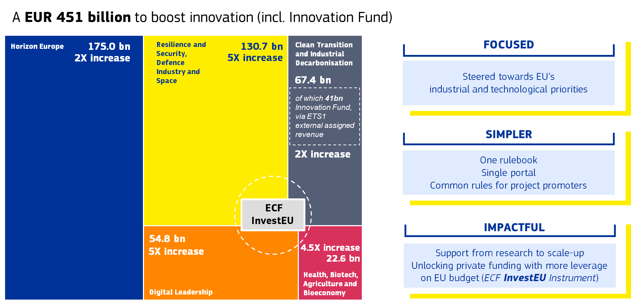
European Competitiveness Fund

Slide 7
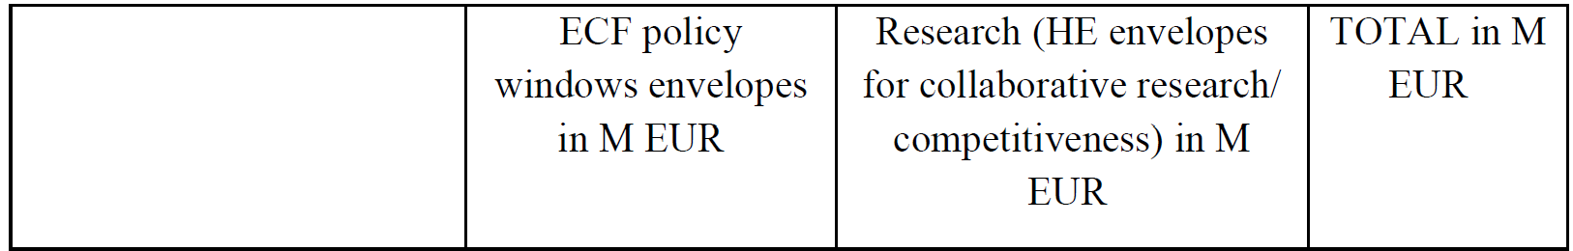
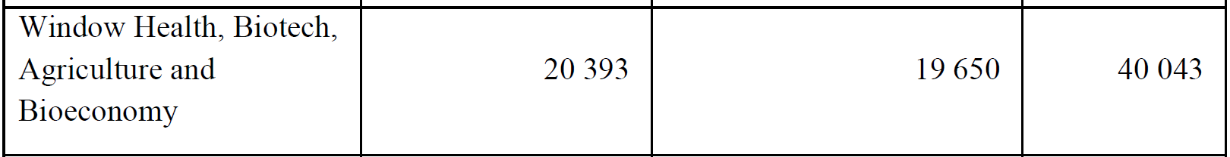
Innovation and competitiveness: ECF
Health shares "window"with Biotech & Bioeconomy and Agriculture
Pillar 2 of Horizon Europe aligns with this window
This would set objectives and initiatives along the entire value chain (from basic research to product or service development)
Proposes a joint Research/Competitiveness programme with common operating rules.
Notes:
The ECF is one of the big winners of the new MFF.
The Health/Biotech window finances testing, manufacturing and industrial scaling.
Risk: health is measured only in terms of competitiveness and market.
Spain has potential if it aligns industry, health and research.

Slide 8
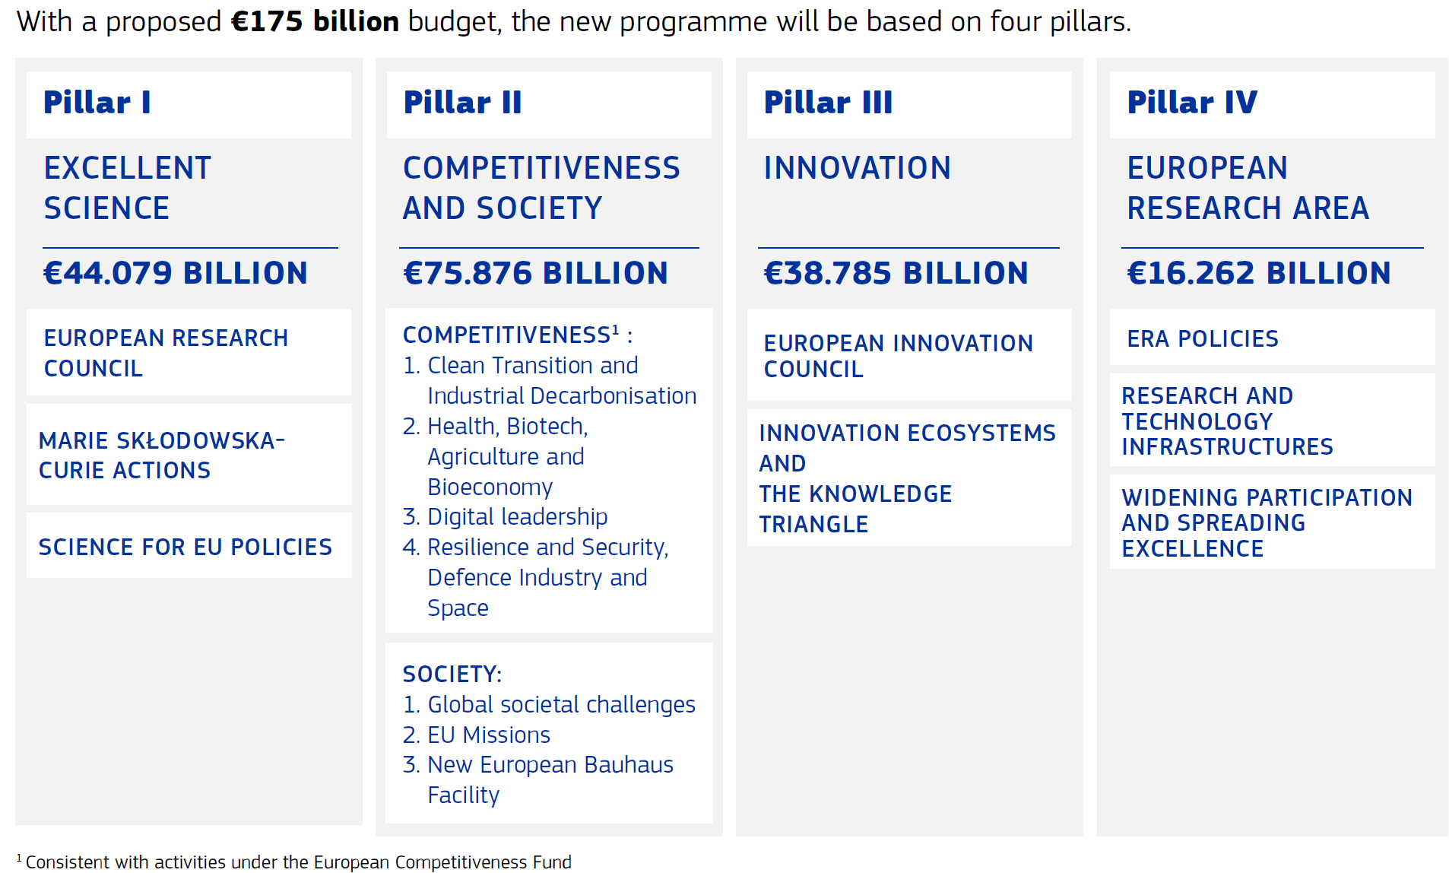
Horizon Europe 2028–2034
Notes:
Horizon remains the main R&D instrument in health.
But its alignment with the ECF implies greater pressure towards applied results.
Issues such as AMR, NCDs or public health should be actively defended in the work programs.
Key role of Spain in committees and partnerships.

Slide 9
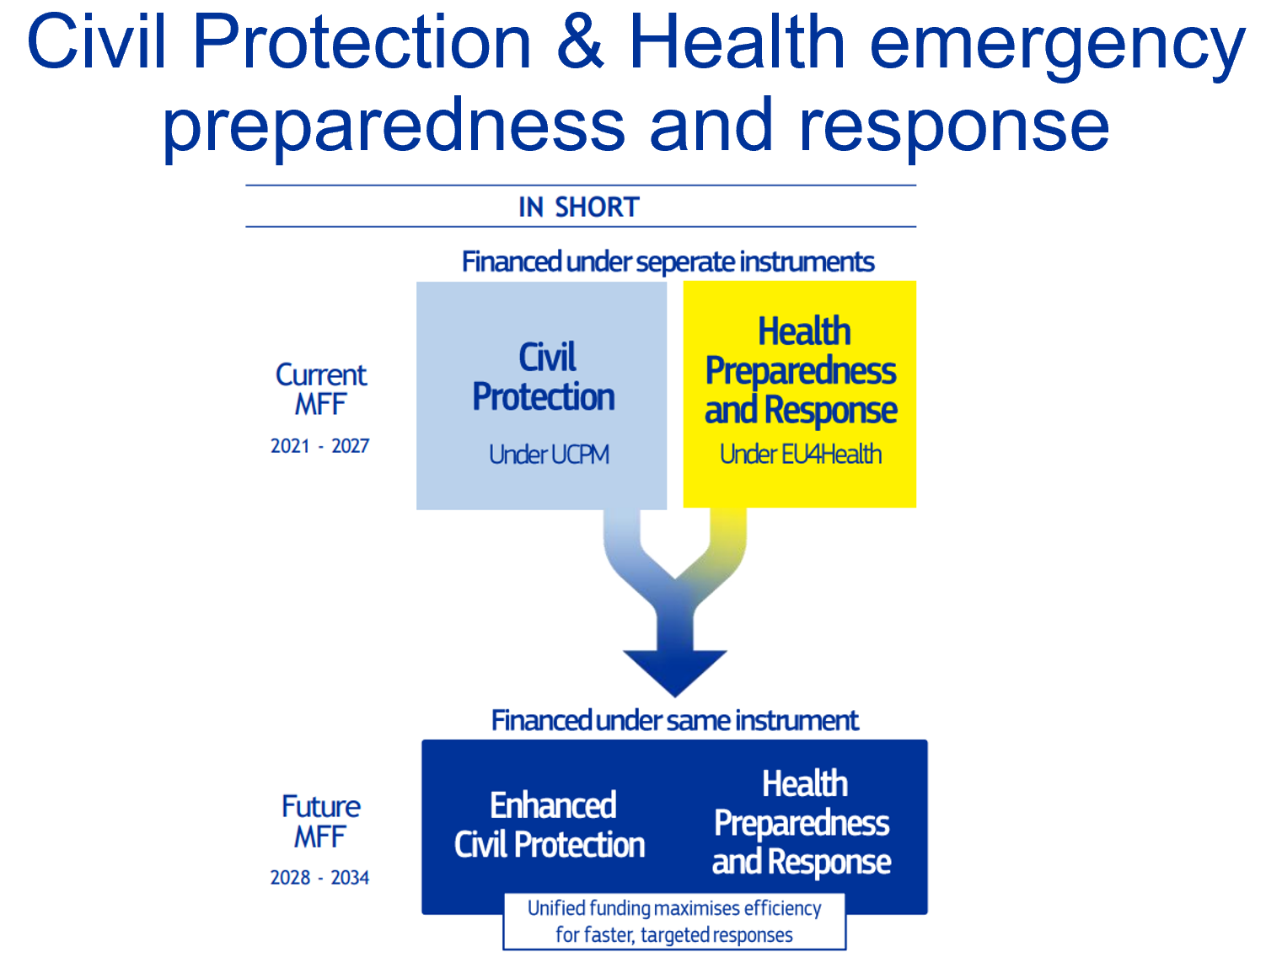
UCPM-HER
Budget ≈ €10.7 billion (No ringfencing devoted to health)
Common Programme & Committee
Notes:
UCPM and HER consolidate the post-COVID logic: preparation and response.
Spain is a net beneficiary of these instruments, but their orientation is reactive.
They do not replace prevention policies or structural strengthening of health systems.
It is important to monitor governance and priorities in work plans.

Slide 10
UCPM-HER
Providing funding to health emergency preparedness and response (previously under EU4Health)
Not interfering with the existing health legislations, in particular:
  Regulation (EU) 2022/2371 on serious cross-border threats to health
  Regulation (EU) 2022/2372 on a framework of measures for measuring the supply of crisis-relevant medical countermeasures
  HERA Decision C(2021)6712
No change to the mandates of HERA Board and
Health Security Committee

Slide 11
National and Regional Partnership Plans (NRPP): key features
Core delivery instrument of the MFF 2028–2034
One single Plan per Member State (national & regional components)
Integrates investments and reforms into a country-specific strategy
Key characteristics
  Payments linked to milestones and targets
  Increased flexibility for Member States
  Strong conditionalities: Rule of Law & Charter of Fundamental Rights
  NRPPs are the backbone of social and territorial spending in the next MFF.

Slide 12
NRPP and health: funds and eligible actions
Funds included
  ERDF – European Regional Development Fund
  ESF+ – European Social Fund Plus
  Cohesion Fund
ERDF: Healthcare infrastructure and equipment; Digital health and e-health; Strengthening regional health systems
ESF+: Health workforce and skills; Mental health and community-based services; Reducing health inequalities
Social objectives: Minimum 14% of NRPP spending

Slide 13
Role of the European Parliament
Mandatory consent of the financial part of the MFF (no negotiation)
Key power in sectoral regulations (trilogues)
Advocacy for social priorities
Current messages:
Question the size of the budget,
Criticises the governance set out in the “national plans”;
It demands more democratic control.
Notes:
The European Parliament is a potential ally.
Although it does not co-legislate the MFF, it can block it and condition sectoral regulations.
Spain must work with key MEPs (ENVI, BUDG, ITRE).
Special attention to resolutions and political amendments.

Slide 14
Risks/Uncertainties
Insufficient budget compared to political ambitions
The overall size of the MFF does not grow proportionally to:
  new priorities (defence, security, competitiveness),
  structural crises (climate, health, demographics),
  and inherited obligations (reimbursement of the NGEU).
Risk of “doing more with the same”, implying:
  implicit cuts,
  dilution of impact,
  conflicts between policies.
Disappearance or dilution of key policies (e.g. health)

Slide 15
Risks in Public Health, NCDs and Pandemic
Prevention and promotion with indirect funding
Risk of underfunding of NCDs
Pandemic preparedness prioritizes crisis, not prevention
Continuity of crossborder proyects / tools (ERNs, EU plans on NCD …)
Issues of importance to ES
  High burden of NCDs, aging and mental health
  Strategic interest in prevention, territorial equity and public health
  Barriers to access for NGOs, scientific societies and health administrations.
Notes:
Central critical message:
- Pandemics: well covered in response, weakly in prevention.
- AMR: risk of becoming invisible.
- NCDs: They depend almost entirely on the national will.
Spain can lead a pro-prevention coalition in EPSCO.

Slide 16
Timeline
2nd Sem 2025 1st Sem 2026 2nd Sem 2026 2027
EP position
Agreement / Council confirmation - EP
MFF adoption by COM
Approval of work programmes (advice)
Council General Orientation Agreement
Negotiation - Council
Negotiation Council – Parliament
Preparation COM work programmes)
Negotiation – Parliament

Slide 17
Thank you very much !

