Slide 1

EU RESOURCES HUB FOR SUSTAINABLE INVESTING IN HEALTH
SLOVENIAN NATIONAL PROJECT SCOPE
DUŠAN JOŠAR, MoH
ES-IT Cluster meeting & Capacity Building Workshop,
29-30/01/2026 Madrid, Spain

Slide 2
Main Area of the National Project and Policy Context
  Access to primary health care (PHC)
CONTEXT
  central role of PHC in Slovenian health care system
  large number of people not having a selected personal physician
  difficulties when accessing their chosen personal physician, even if they have one
CHALLENGES
  challenges in the governance of primary care
  challenges in ensuring the necessary human resources
  reorienting digitalization development so that the needs of clinicians and other carers are better considered

Slide 3



Project Overview
Improve access to primary care
mainly through organizational interventions
Centre for coordination and development of primary health care
National call centre for primary health care
Standardization of triage procedure in primary health care

Slide 4

Project Overview
Structure of the project
Project coordinator:
Improve access to primary care
mainly through organizational interventions
Good practices
Consultation with stakeholders
Scenarios/options
Good practices
Overview of triage guidelines
Pilot implementation of nat’l call centre
Adoption of appropriate guidelines and related training programme
Groundwork for the centre
Outline of requirements for nat’l call centre
Establishment of new nat’l call centre
Nat’l implementation of training programme
Support in identification of EU funds for these activities

Slide 5
The role of Technical Support Instrument
Potential EU funds to be targeted
Improve access to primary care
mainly through organizational interventions
Technical support instrument
Twinning project
Taiex,
EU4Health
Cohesion funds
CEF Digital
Digital Europe
EU4Health
Horizon Europe
Cohesion funds
Erasmus+
InvestEU

Slide 6




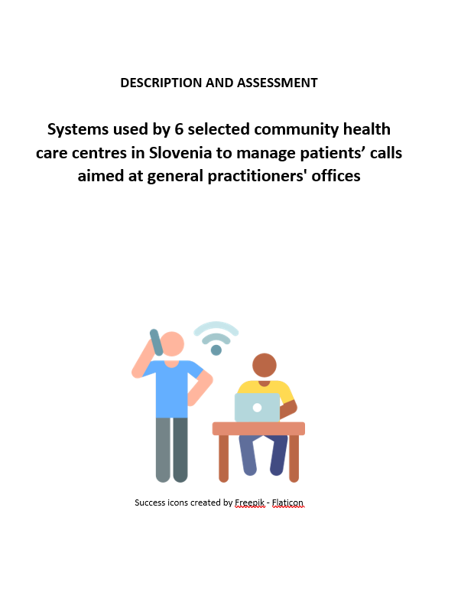
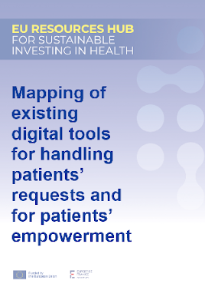
DELIVERABLES
Telephone Triage and Advice Service
Adoption of solutions
Secure funding
Implementation
Training of personnel

Slide 7
THANK YOU

Slide 8


