Slide 1


Strategic Workforce Enhancement & Investment: Technical Support Instrument: The Italian EU Resources Hub for sustainable investing in health: a case study on health workforce and smart programming tool using AI
Madrid 29 -30 January 2026

Slide 3
Buongiorno tuti! Buenos dias a todas!

Slide 4
TSI: The Italian EU Resources Hub for sustainable investing in health

Slide 5
Project objectives
Support the implementation of the framework for workforce reform | Finalisation of a comprehensive Framework for Italian Health Workforce Reform
 | Implementation of the Italian Workforce Reform Framework and capacity building
 | Evaluation, institutionalisation, and sustainability
Support the development of a ‘hub’ for health workforce investment in Italy | Development of an Italian Health Hub to align strategic investment in health . Including:
 | Implementation of the National Plan for Governance and Italian participation in European Global Health Initiatives
 | Project(s) involving selected regional authorities
 | Evaluation, institutionalisation, and sustainability

Slide 6
Project Phasing
Scoping and implementation options appraisal
Early adoption and iteration
Institutionalisation
Year 1: 2025/26
Year 2: 2026/27

Slide 7
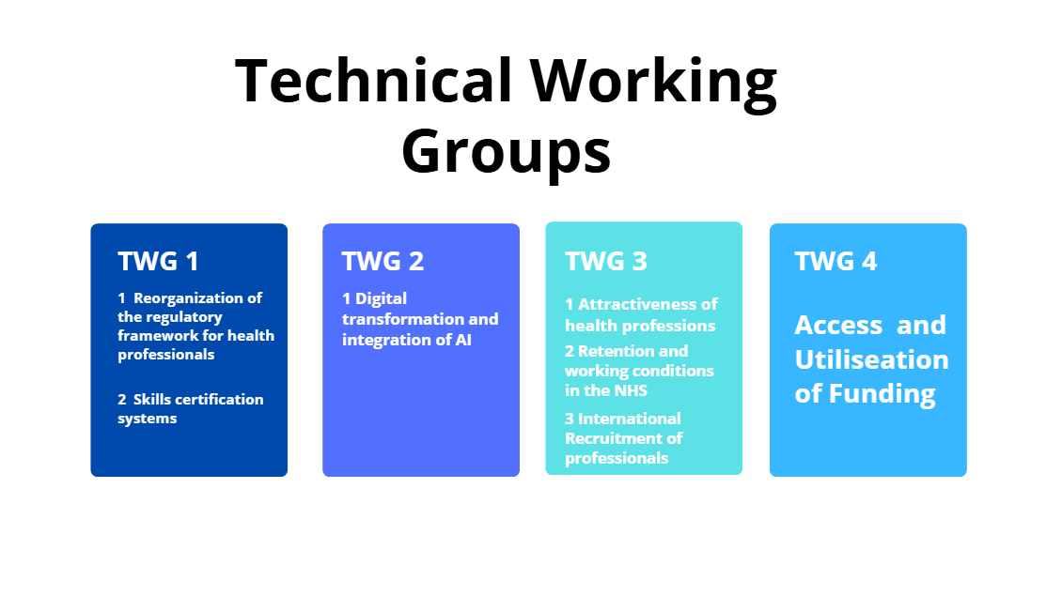
Description of the Needs
This framework serves as a mechanism for renovating a complex structure.
In six critical areas, focusing
legal foundations (regulatory framework)
tools (digitalisation/AI)
improving the intake and retention
necessary to sustain the Italian health system.
Six Strategic Areas for Reform
Reorganisation of the health professions’ regulatory framework.
Digital transformation and integration of AI.
Recruitment of foreign-qualified professionals.
Policies to enhance the attractiveness of healthcare professions.
Initiatives to improve retention within the SSN.
Certification of healthcare professionals’ competencies.
Cross-Cutting Needs
Stronger vertical coordination (State–Regions).
Integration across education, labour, and health sectors.
Evidence-based policymaking and peer learning (esp. with Spain).

Slide 8
Priorities: National Plan for Governance and Italian Participation in European Global Health Initiatives
Activities
Strengthening governance and policy synergy
Promote coordinated national actions as part European Health initiatives
Strengthen Italian Contributions to European and international organisations
Objectives
Deliver better health outcomes across a citizen's life course
Strengthen health systems and advance universal health coverage
Fighting health threats including pandemics and anti-microbial resistance

Slide 9
Priorities: Italian Framework for Workforce Reform
Objectives
Increasing the attractiveness of health careers
Reorganising health professional profiles
Certification of competencies
Retaining health workers in the NHS
Recruitment of International Health Workers
Digitalisation and AI tools

Slide 10
Common themes and critical enablers
Strong, multi-level governance alignment
Both initiatives strengthen coordination across EU, national, and regional levels to ensure coherent policy and implementation.
Shared resilience and workforce goals
Each prioritizes building a more resilient health system by investing in a sustainable, capable, and well-planned workforce.
Strong EU strategic coherence
The National Plan and TSI Hub both align closely with European strategies, frameworks, and joint initiatives.
Coordinated investment and planning
Emphasis on better use of national and EU funds through structured planning and investment alignment.

Slide 11
Vision of the Healthcare Investment Hub
A strategic national platform that strengthens how Italy invests in health and the health workforce
Align investments with national priorities by connecting reforms, funding, and long-term workforce needs.
Coordinate national, regional, and autonomous provinces’ efforts to ensure coherent and equitable resource allocation.
Enable strategic access to EU funds through a unified structure that improves planning, application, and utilisation.
Promote transparency and good governance across institutions responsible for spending and managing health-related financing.
Support sustainable workforce reform by linking financial decisions to workforce planning, skills development, and service needs.

Slide 12
What the Healthcare Investment Hub Will Achieve
A unified engine for smarter, more sustainable investment in Italy’s health system
Strengthen system capacity to design, manage, and coordinate major health investments, including EU and national funds.
Improve efficiency and reduce fragmentation in the way regions plan and use health workforce financing.
Create a national network of contact points to support consistent collaboration, communication, and implementation.
Provide evidence for decision-making through baseline assessments, data analysis, and shared tools.
Enable scalable, long-term reform by testing the Hub, refining the model, and institutionalising it for nationwide use.

Slide 13
The TSI nested in the National Plan for Governance & Italian Participation in European Global Health Initiatives (2026–2030)
Purpose & Vision
Positions Italy as a proactive European/global health actor using a One Health, cross-sectoral, resilience-focused approach.
Core Objectives
Strengthen national governance and policy coherence.
Coordinate Italy’s role in EU initiatives.
Enhance contributions to EU and international organisations.
Strategic Priorities
Improve population health and equity.
Strengthen health systems, skills, and digitalisation.
Reinforce preparedness, response, and AMR action.
How the Plan Works
Governance mechanisms:
Establishes structured processes for planning, coordination, and oversight across institutions.
Co-programming actions:
Aligns national and EU strategies through joint analysis, shared priorities, and regular synergy checks.
Technical liaison tools:
Uses dynamic mapping, communication platforms, and thematic working tables to link actors and opportunities.
Operational support:
ProMIS provides technical coordination, develops shared tools, and ensures consistent implementation across regions.

Slide 14
Strategic Synergies Between the National Plan & the TSI
Strong, multi-level governance alignment
Both initiatives strengthen coordination across EU, national, and regional levels to ensure coherent policy and implementation.
Shared resilience and workforce goals
Each prioritizes building a more resilient health system by investing in a sustainable, capable, and well-planned workforce.
Strong EU strategic coherence
The National Plan and TSI Hub both align closely with European strategies, frameworks, and joint initiatives.
Coordinated investment and planning
Both agendas emphasise better use of national and EU funds through structured planning and investment alignment.

Slide 15
Common Threads Driving Both Agendas
One Health, systems thinking
Both frameworks apply holistic, cross-sectoral principles to address complex health and workforce challenges.
Shared reform priorities
They converge on key priorities such as preparedness, system strengthening, and digital innovation.
Data-driven governance tools
Each relies on monitoring, indicators, and evidence-based processes to guide decision-making and track progress
Broad stakeholder engagement
Both depend on active participation from ministries, regions, agencies, EU institutions, and WHO.
Aligned national–EU investments
They aim to integrate and harmonise national policies with European funding mechanisms for greater impact.

Slide 16
Grazie Mille! Muchas Gracias!

