Slide 1



Main outcomes and lessons learnt
Capacity Building Workshop for EU instruments
29/01/2026

Slide 2
Background
Challenges & opportunities:
Covid pandemic put additional pressure on the financing of health system, while generated new sources of funding both at national and EU levels.
Shared conviction on the importance to invest in health systems resilience
Matching needs with resources:
Many EU funding programmes were available for supporting investments in health. But health authorities struggle to find their way in this complex funding landscape: multiplicity of programmes, various timescales, heavy workload for application, co-funding requirements…

Slide 3




Project ‘Resources Hub for Sustainable Investing in health’
Under the Technical Support Instrument 2022 (DG REFORM)
Multi-country project: Austria, Belgium & Slovenia
2022-2024
Two work streams:
1. Making the case for public investment in health
2. Develop a pilot case to strengthen capacity of health authorities to reach EU resources
Final objective: the creation of a “EU Resources Hub”
Providers: Expertise France, European Observatory on Health Systems and Policies, SEO Amsterdam Economics

Slide 4

Workstream 1 – Making the case for health investements
Building capacity to advocate for more public investment in health (national/EU level)
Exploration of different tools and tailored approaches that could be used to make the case for health investment
Health Impact Assessment study of a policy measure targeting the reduction of tobacco selling points in Belgium (Inter-federal Strategy for a smoke-free generation):
Collaboration between Sciensano, FPS Public Health, Food Safety and Environment, FPS Finances and FPS Economy
Collaborative learning process, knowledge sharing
Proposal to embed HIAs in the future for the design and implementation of evidence-based federal public health policies

Slide 5

WS2 - Support Health Ministries to navigate and identify EU funds and instruments
Strengthening the capacity of national public health authorities to reach EU funding available for health
Persisting obstacles: lack of knowledge of existing opportunities, division of powers inside a Federal State, lack of sufficient expertise/time/human resources for applications, competitive processes coupled with uncertain results…

Slide 6
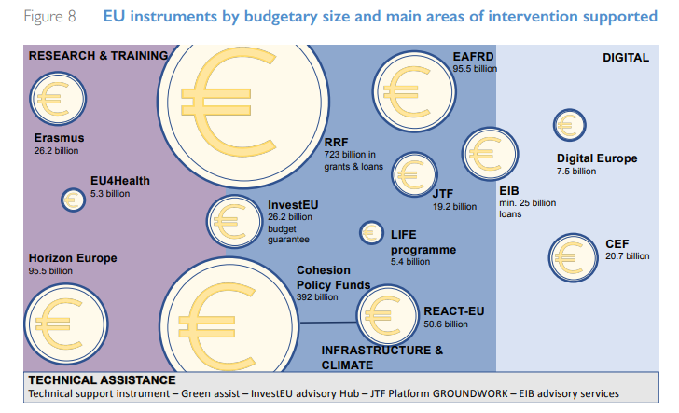
Workstream 2 – Support Health Ministries to navigate and identify EU funds and instruments
Case studies: a ‘learning by doing’ approach, to pilot and test a concept of EU Health Resources Hub

Slide 7
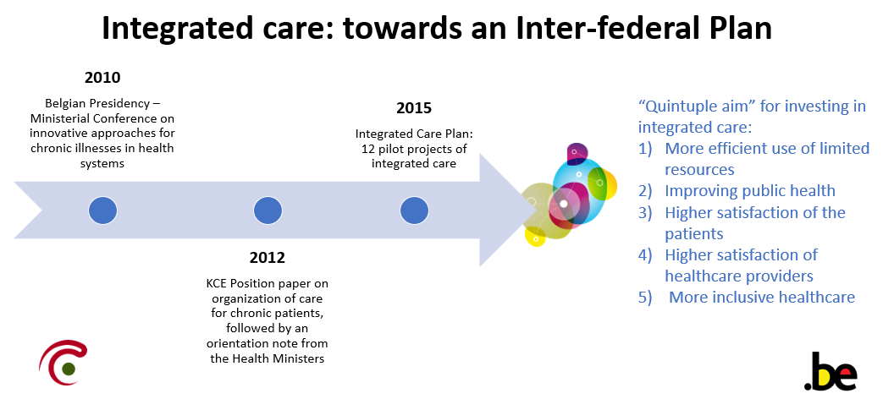
Selection of a pilot case for BELGIUM

Slide 8
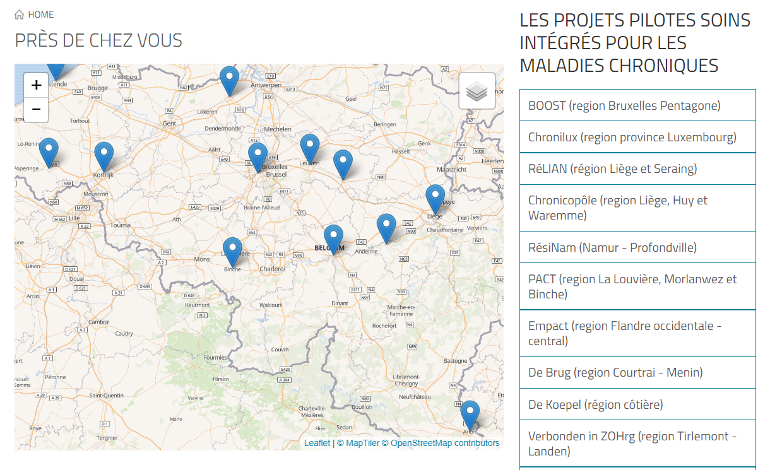
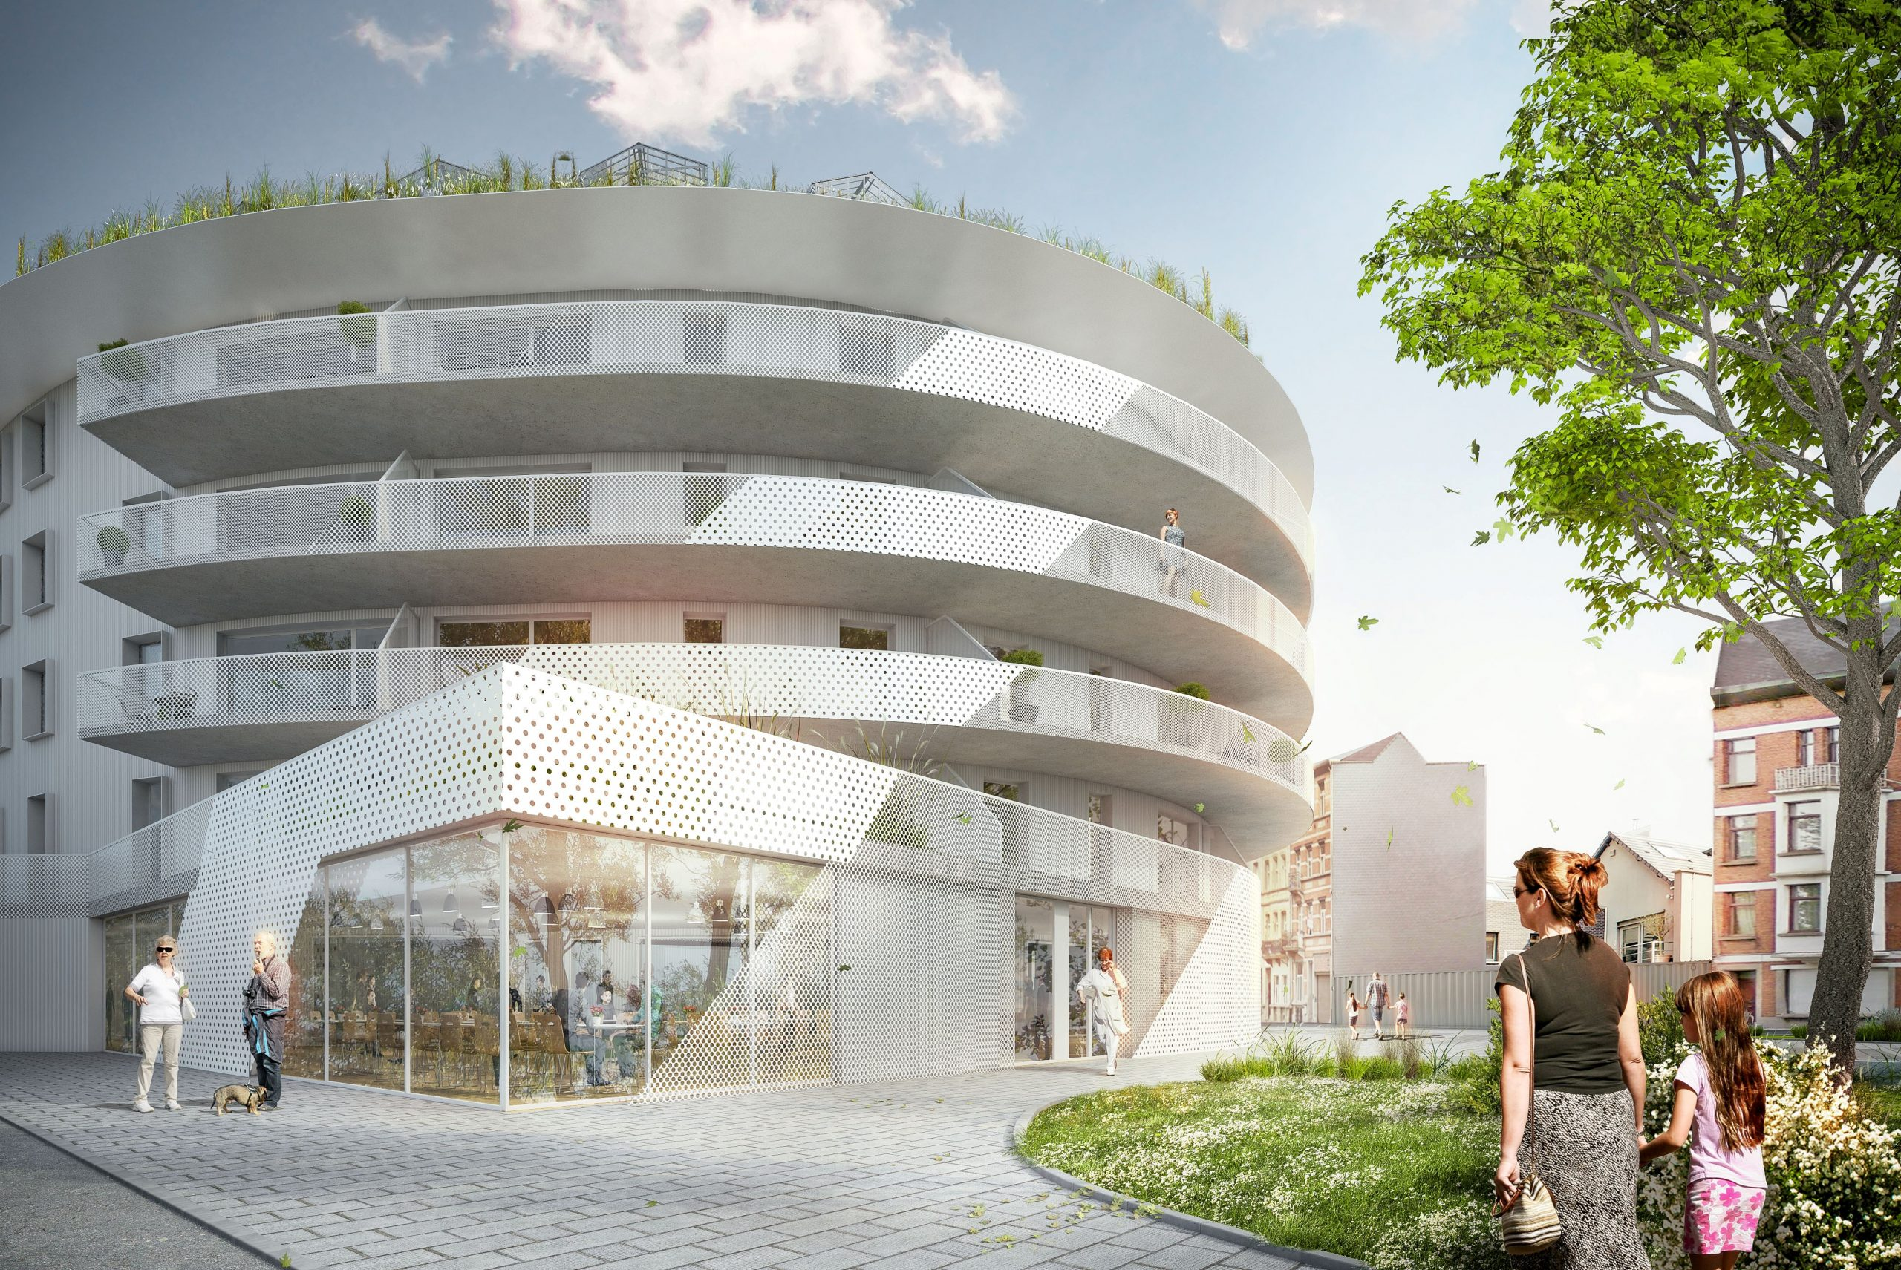
Inter-federal plan for integrated care in Belgium
Macro = political level
Meso = governance of partnerships set up at local level
Micro = patients or healthcare providers' level
Notes:
The European project “CSSI Médecins du Monde” is providing social and healthcare in Brussels, Belgium. The centre provides an offer of medical care, social services, debt management advice and psychological support. The project includes two health and social centres. The second one is still being built in Cureghem, Anderlecht, one of the more deprived districts in the Brussels region. The project addresses the problem that, according the NGO Médecins du Monde, 30% of residents in and around Brussels are not registered with a GP so far. Have look at the latest episode of Smart Regions setting an example for social inclusion!
European Regional Development Fund (ERDF): 3,72 millions €
50% co-funded

Slide 9

Selection of a pilot case
Population Health Management (PHM) is central to the success of implementing integrated care in Belgium
Preparation of a new inter-federal Integrated Care plan in collaboration between federal and regional authorities to fully embed integrated care at all levels in Belgium.
Belgium’s evolution to a health and wellbeing system and population-centered organisation of care
Data integration and digital solutions as key enablers for implementing a PHM strategy
Notes:
PHM is considered a critical building block for integrated care systems.
Population health begins with the patient, enable us to learn about different population “cohorts” within and between regions, study trends, adapt policies accordingly for improved care outcomes. PHM will enable local health and care partners to deliver care that is tailored to the population’s needs and as close to home as possible.
The Belgian pilot has been drawn up in the context of the upcoming Inter-federal plan on Integrated Care to be implemented in 2024. PHM is a strategic aim of integrated care systems. Its innovative approach however requires both investments to build capacities in different areas as well as developing the necessary data and IT infrastructures to support its implementation.

Slide 10
Workstream 2 – pilot EU Health Resources Hub
Inter-federal plan for Integrated Care / Digitalisation: Developing digital tools for data integration to support Population Health Management (PHM)
Preparatory phase for the development of a future dashboard to support PHM
Collaboration between FPS Public Health, Food Safety and Environment, federated entities, 3 Belgian universities and international experts ; policy dialogue for the development of a PHM strategy in a spirit of mutual learning
Aim: creation of a fully fledged dashboard in 2025, expected to be funded through the RRF

Slide 11


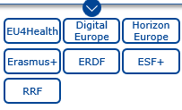



FOUNDATIONS
DASHBOARD
PHM coaching and capacity-building on dashboards to support PHM for policymakers
Mapping of population health needs
Identification of data needs by assessing data available and data gaps
Establishment of a set of preliminary indicators
Segmentation of the population to establish target subgroups for tailored actions
Consideration of data protection/security issues
Leverage existing national, regional & international tools/examples of population health dashboards & databases
Design and creation of a digital dashboard and the accompanying IT infrastructure with software experts
Dashboard implementation starting with a test phase
Notes:
Seizing EU funding opportunities to support MS’ endeavours in health systems strengthening and digital transformation in healthcare is not a straightforward exercise.
A first assessment demonstrates that:
there are several challenges for MS’ mono-beneficiary projects/reforms to access funds through programmes managed directly by the European Commission (e.g. Digital Europe, EU4Health) e.g. fulfilling the requirements, meeting all eligibility criteria and facing considerable competition in the lengthy application process.
Calls for proposals issued tend to be limited in scope and not sufficiently broad to capture MS needs and priorities
Optimising the use of shared management funds (e.g. ERDF/ESF+) and the RRF for health could be considered further but this requires collaboration and ensuring that health is included during the priority setting and programming phases
Facilitating more effective blending of different EU funds as well as EU and national funds for national health projects would be valuable.

Slide 12
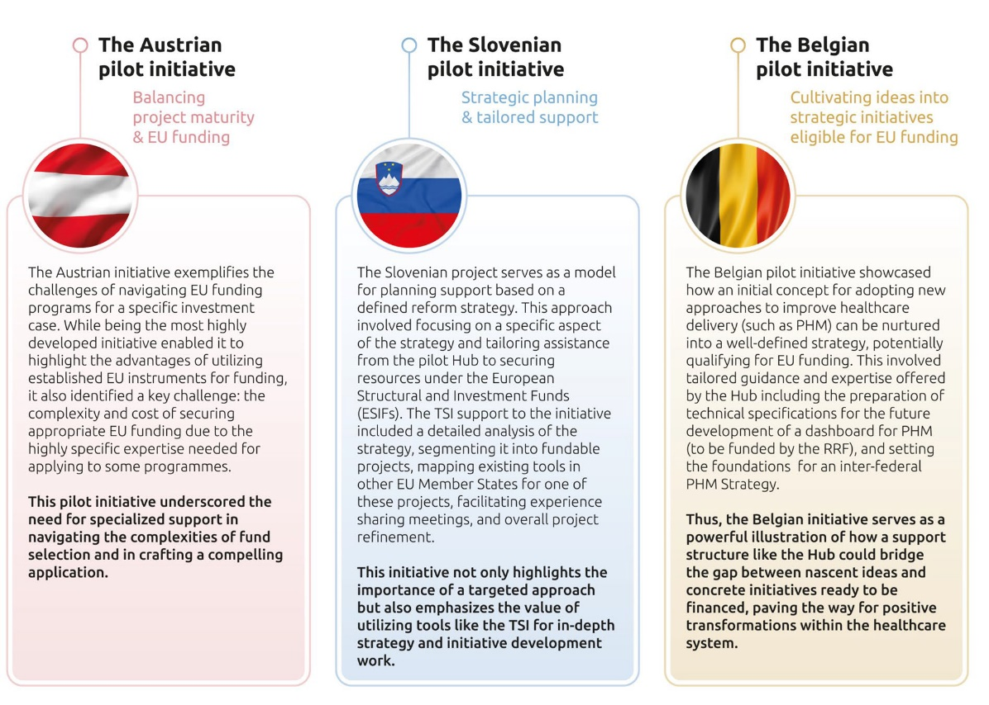

Slide 13
Lessons learnt from the pilot projects
Coupling strategic political will and administrative know-how
Aim big: adopting a broad and visionary approach and setting ambitious goals ensures that efforts will have a meaningful impact and be worth the resources invested.
Comprehensive tailored support, from the start: need for early, proactive technical support with direct relationships
Capacity building
Alleviating administrative burdens

Slide 14
Main outcomes
Support to National Pilot projects
Evaluation of the support provided to the national pilot projects
EU Health Resources Hub Concept: in-depth analysis
Manual to support MS in using EU funds
Communication and dissemination
Council Conclusions under the Belgian Presidency
NFPs meeting and willingness to strengthen national capacities
Discussion within the EU4Health Programme

Slide 15
A EU-level Health Hub as a support service for Member States
Background: 2021 – Slovenian Presidency of the Council of the EU: the Council invited the Commission to explore setting up a dedicated health advisory service to assist Member States upon request in optimising the use of EU funds and tools to support the planning, design, financing and implementation of needed health system reforms.
a mechanism that would function like a “one-stop shop”/single entry point for accessing health funds, open to all Member States

Slide 16
Council Conclusions – A Europe that cares, prepares and protects
23. Strategic investments in health are crucial to reinforce the sustainability and resilience of European health systems. The EU provides multiple funding streams at the disposal of Member States and stakeholders. However, Member States face challenges finding and accessing existing EU funds to support impactful investment in national health system transformations. It is of great importance that the work programmes of the EU existing funding instruments promoting research & innovation and those supporting implementation of policy initiatives are in synergy with national priorities in the health area and the nexus between research, innovation, policy and funding instruments is upheld.

Slide 17
IX. improve EU implementation tools
INVITES the MEMBER STATES and the EUROPEAN COMMISSON to:
83. INITIATE an in-depth discussion in the EU4Health Steering Group in order to make the mechanism of joint actions more effective and sustainable in addressing future trends in health and Member States needs to implement priority areas within the EU Health Union.
84. STRENGHTEN the coordination between policy and funding instruments, ensuring that available EU funding continues to be used in a strategic, effective and sustainable manner, in line with health priorities of Member States and taking into account technical support, with a focus on implementing transformations with long-term impact.
85. ASSESS the current landscape of EU funds and its corresponding legislative framework to better align EU funding with Member States national health policy priorities.

Slide 18
INVITES THE EUROPEAN COMMISSION TO:
86. ESTABLISH an EU Health investment Hub in consultation with Member States and taking into consideration the lessons learnt from the Technical Support Instrument project “EU Resources Hub for sustainable investing in health”, to provide on-demand, tailored and fit-for-purpose support to Member States in accessing and using existing EU funds delegated to Member States for the planning, financing and implementation of national health projects of high interest and impact and within the context of national health reforms and health care transformation processes, as well as identifying opportunities from different EU programmes for projects with objectives that span across multiple EU funding instruments and their priorities;
87. IMPROVE and update the procedures to facilitate access to existing fundings.

Slide 19
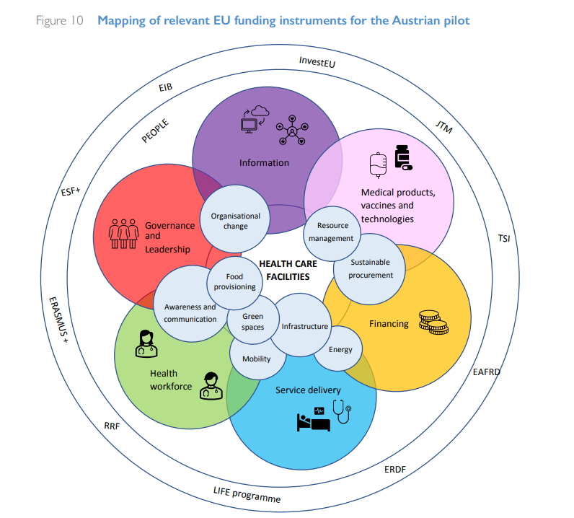

Slide 20
Council Conclusions 2024
INVITES THE EUROPEAN COMMISSION TO:
86. ESTABLISH an EU Health investment Hub in consultation with Member States and taking into consideration the lessons learnt from the Technical Support Instrument project “EU Resources Hub for sustainable investing in health”, to provide on-demand, tailored and fit-for-purpose support to Member States in accessing and using existing EU funds delegated to Member States for the planning, financing and implementation of national health projects of high interest and impact and within the context of national health reforms and health care transformation processes, as well as identifying opportunities from different EU programmes for projects with objectives that span across multiple EU funding instruments and their priorities;

Slide 21
Concept of the EU Health Hub
Unlocking EU potential and opportunities by tapping in and making a strategic use of EU funds, including the blending of different instruments, for impactful health investments.
Make a better and more strategic use of existing funds
Flag health in funding programmes
Support to all Member States in a flexible, demand-driven and simple way; moving from a competitive perspective to collaboration on shared goals
General and tailored services
Collaboration with strategic partners

Slide 22
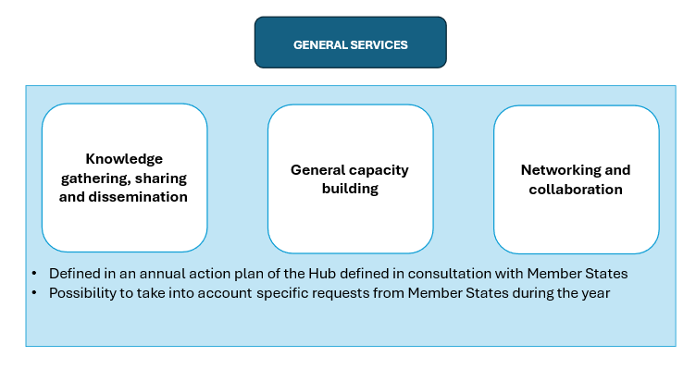
Potential services

Slide 23
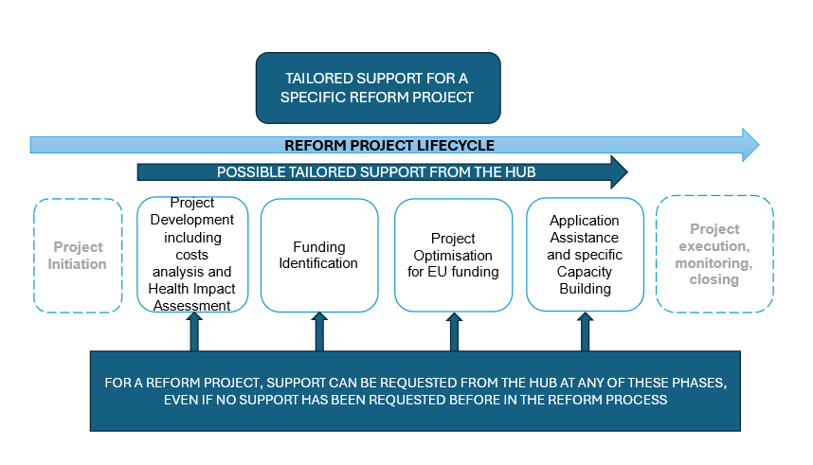
Potential services

Slide 24
Thanks!
Any question?
anne.swalue@health.fgov.be
ibri@health.fgov.be

