Slide 1
Pilot Testing on Urgent Needs for Digital Skills

Slide 2
A few words about BeWell
Co-funded by the Erasmus+ programme of the European Union under Grant Agreement number 101056563

Slide 3
Promote the upskilling and reskilling of the European health workforce.
The BeWell project addresses the need to prepare the health and care workforce for green and digital solutions introduced in the European health and care systems, to ensure they can respond to current and future challenges.

Slide 4
Pilot Testing on Urgent Needs for Digital Skills

Slide 5
Dear colleague,
On behalf of the BeWell consortium, we invite you to join the Pilot Testing of the Training programmes developed for Urgent Needs for Digital Skills.

Slide 6
The Pilot Testing will focus on the following nine topics:
Telehealth (televisiting, telemonitoring, telenursing, telemedicine, wearable devices)
Digital tools for Problem-solving
Increase Office and Google Suite knowledge
Healthcare data protection management (General Data Protection Regulation [GDPR])
Cybersecurity in Healthcare
Big Data & Analytics
Healthcare ICT (Radiology Information Systems, Picture Archiving and Communication Systems, Electronic Health Records)
PACS, e-file, RIS
Telemedicine

Slide 7
The Pilot Testing welcomes people who are part of the Health and Care Workforce as:
An advanced practice nurse
A bachelor nurse
A healthcare assistant
A doctor
A public health professional
A medical technician
A member of staff (e.g., administrator/management/medical supplier)
A health professional

Slide 8
What will you gain by participating in the Pilot Testing
You will have access to diverse but concrete content that was developed based on the current digital needs of the Health Workforce.
You will also be able to assess your knowledge and skills and further explore new content and information.
Receive confirmation of participation by participating in at least 2 modules of the training programme of your selection filling out the evaluation questionnaire that will be sent to you.
By receiving the confirmation of participation, you will be eligible to receive the Certification of the competences and skills acquired during the Pilot Testing of the Training Programme by the end of the Pilot Testing.

Slide 9
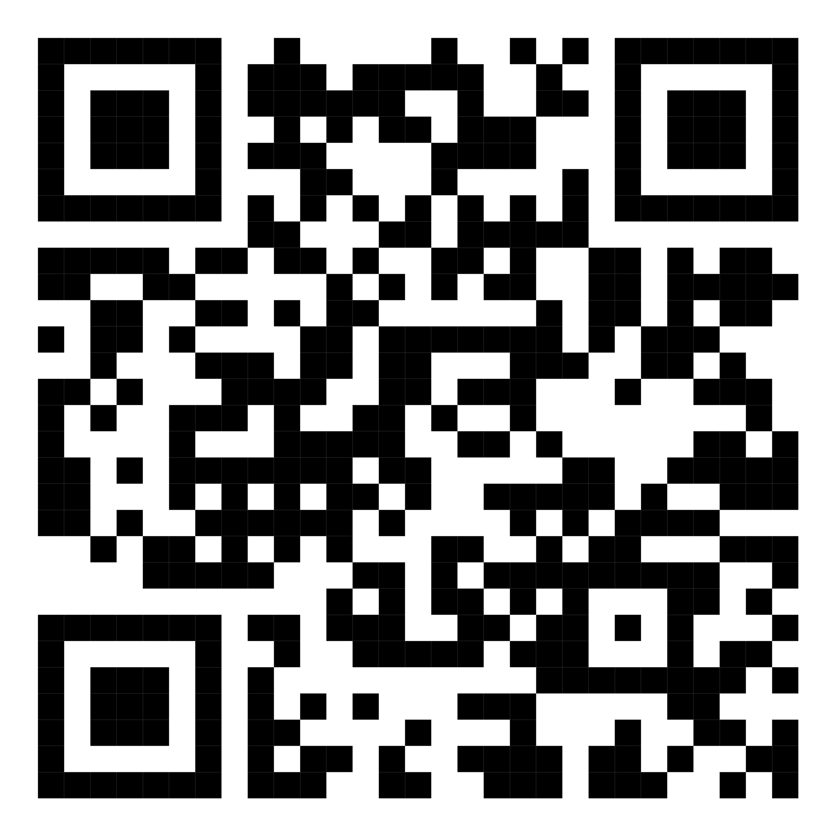
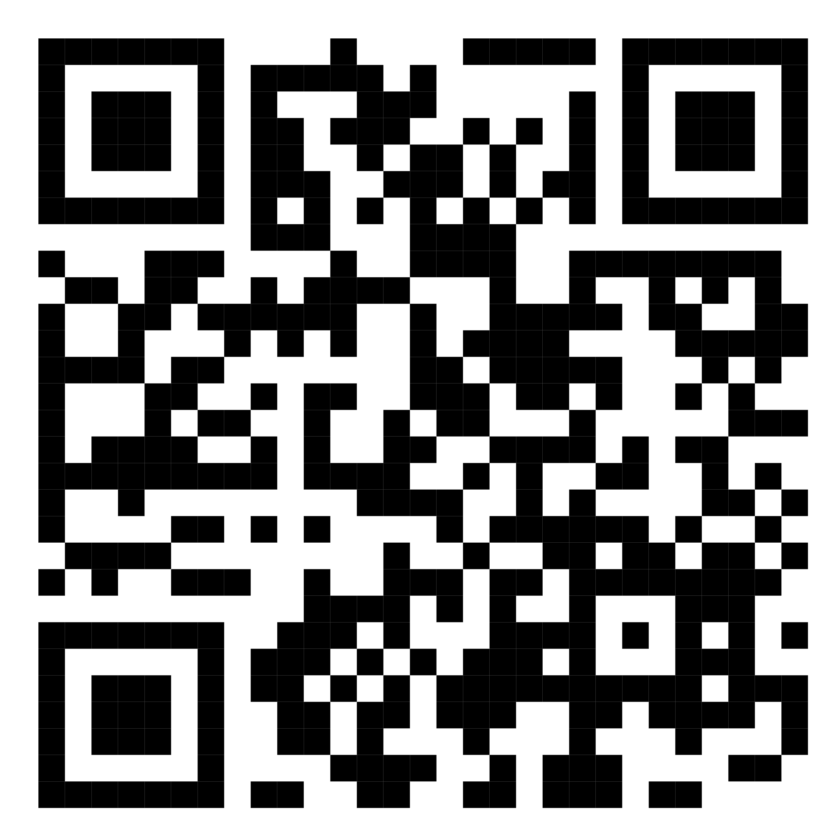
BeWell Pilot Testing links
You can be informed by BeWell’s partners about the launch date and timelines of the Pilot Training Programmes by filling out this Form
You can access the Pilot Testing of the Training Programmes here:
Please click here to see how you can access the training programme.

Slide 10
Thank you!
Kind Regards,
The BeWell Consortium

