Slide 1
Harnessing data for better
cancer care
9 marzo 2023
PROmis Winter School
Eduardo Pisani

Slide 2
Building efficiency in four dimensions
Notes:
NOTES
Be people-centred = Align all aspects of cancer care and prevention to meet the needs of patients, carers and the general public – in collaboration with people affected.
Take a whole-system perspective = Treat each patient’s care pathway and the entire cancer care system as an integrated whole

Slide 3
Aspirations of efficient cancer care
Measure efficiency
Invest in data
Scale-up solutions
Promote implementation
Deliver accessible, patient-centric, evidence-based and quality care to achieve best possible outcomes and experience for all cancer patients at individual- and population-levels
Drive towards adaptive & learning healthcare systems that enable better and equitable use of resources now and in the future
Data is a driver of efficiency: it underpins a learning healthcare system, acting as a catalyst for a continuous cycle of improvement and driving better use of resources to achieve better outcomes for patients

Slide 4
Data ecosystem in cancer care
Cancer registry data
Electronic health records data
Genomic data
Patient-generated health data
These data are examined in terms of:
What they describe and information provided (contents)
How they are collected and stored
Their intended use and insights that can be derived from them

Slide 5
The role of data in driving efficiency through the care pathway
Screening | Diagnosis | Treatment and care | Follow-up and survivorship
Genomic data can better define and stratify high-risk populations | Genomics data enable a more precise and earlier diagnosis (and treatment) | EHR improve coordination of care | Remote patient monitoring ensures continuity of care after treatment and help signpost people to services they need
AI can optimise accuracy of findings based on imaging data analysis | AI improves speed and accuracy of diagnosis | Educational alerts in HER improve provider adherence to guidelines
Linking screening data sets with registry data can help monitor impact on outcomes | Linking data sets help identify optimal pathways to diagnosis | PROMs ensure care plans are adapted to patient symptoms
 | Data-sharing hubs foster better diagnostic sharing and reduce duplicative tests | AI help optimise care processes by supporting treatment planning, scheduling etc.

Slide 6
Addressing challenges inherent in data (1)
What can policymakers do?
Create national data quality standards and regularly audit data systems against these measures
Demand greater equity in cancer research and care. Ensure representation of people of different races and ethnicities, sex and cancer types in cancer data sets
Systematically collect data that are most relevant to patients in key national data sets and use them to evaluate healthcare system and provider performance
Challenges:
Poor quality
Data not being representative of entire populations (inequity and bias)
Lack of data on the patient perspective

Slide 7
Addressing challenges with data systems (2)
What can policymakers do?
Develop common data standards, specifications and processes for data collection
Build harmonised data governance legislation to facilitate health data linking and sharing between providers, using national health data codes of conduct
Engage with patients to discuss how data are being used, and address misconceptions around the nefarious use of health data.
Continuously adapt legislation and tools to give citizens appropriate control over their health data, so they may act as their own data ‘gatekeepers’
Challenges:
Limited interoperability of data sets
Inconsistent use of data governance frameworks
Low patient trust

Slide 8
Addressing challenges embedding data into clinical practice (3)
Challenges:
Limited actionability of data
Poor integration of data insights into clinical decision-making
High burden of data collection on care teams
What can policymakers do?
Build in positive incentives for data collection and use across the cancer care pathway, to foster a culture of value-based healthcare.
Embed data-analytic solutions into care processes to enable rapid processing and feedback of data insights to clinical teams to guide decision-making.
Provide appropriate funding and resourcing to train and upskill the healthcare workforce so that they keep pace with innovations in data collection and use.

Slide 9
Addressing challenges in drawing insights from data (4)
What can policymakers do?
Apply appropriate regulatory standards to fundamentally protect citizens’ rights and values by ensuring that:
data sets from which insights are drawn are adequate, equitable and sufficiently representative to train artificial intelligence algorithms while minimising potential biases
the analytics used are standardised, transparent and subject to rigorous evaluations of clinical safety and effectiveness
the insights drawn from data analysis are of high quality.
Challenges:
poorly validated algorithms and inadequate analytical methodologies
lack of trust in artificial intelligence

Slide 10
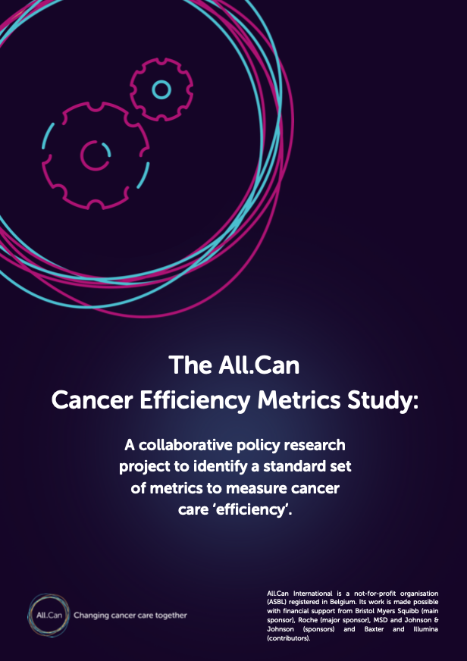
New report by All.Can – June 2022
The report identifies an evidence-based suite of cancer care efficiency metrics.
These can be applied, albeit in varying ways, by multiple stakeholders across the cancer care continuum and across many countries to assess, consistently benchmark and improve efficiency in cancer care.

Slide 11
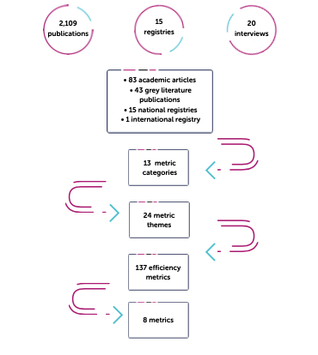
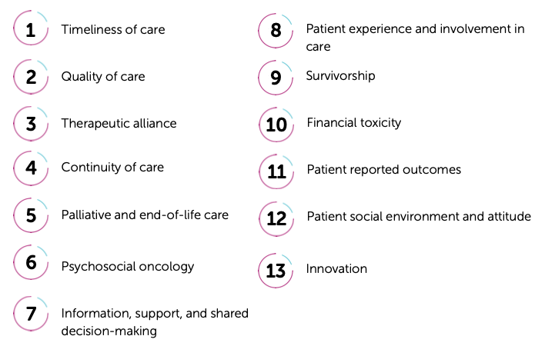
Key findings: Themes in Cancer Care Efficiency
Notes:
The greatest overlap existed between the categories identified in the research and the count of times these category themes were mentioned in stakeholder interviews, were: (34 , 34, 30 counts in stakeholder interviews).
3 new themes also evolved: Patient and social environment, Innovation and PROMs (including Quality of Life), especially long-term post-treatment monitoring. Indicating that QoL should be included in assessment of efficiency, where multifactorial assessment accounted for.

Slide 12
Key findings – 24 Cancer Efficiency Metric Themes
Timeliness of Care
Swift diagnosis
Optimising routes to diagnosis
Appropriate and clinically indicated diagnosis
Efficient referral to specialist services
Early treatment initiation
Quality of Care
Physician adherence to national guidelines
Coordination of specialist resources
Role of multidisciplinary teams (MDTs)
Patient-reported outcomes (PROs) in routine care
Patients’ perceptions of care quality
Continuity of Care
Adequacy of follow-up pathways
Patients’ experiences of COC
Patients’ and families’ perceptions of palliative & EOL care
Aggressiveness of end-of-life care
Psychosocial Oncology
Psychosocial screening of high-risk patients
Impact of cancer on family and patient relationships
Information, Support & Shared Decision-Making
Patients’ perceptions of physician communication
Patients’ experiences with decision-making
Relationship between patients, caregivers, oncologists
Patient Voice in Patient Care
Patient satisfaction, experience, and involvement in care
Collaborating with patients to improve care quality
Survivorship
Social support for patients and family
Survivors’ concerns and perceptions of support
Financial toxicity
Financial impact of cancer on patients
Notes:
These findings from stakeholder interviews also align with All.Can’s patient survey on cancer care efficiency, where respondents reportedly experienced inefficiency, namely:
Swift, accurate and appropriately delivered diagnosis Information,
support, and shared decision-making
Integrated multidisciplinary care
The financial impact of cancer.

Slide 13
Key findings – 8 Core Cancer Efficiency Metrics
Examining cross-referral of the 137 metrics led to identification of 8 core indicators reported consistently across all data sources (health literature, registries and stakeholder interviews).
These real-world measures of cancer care efficiency
are routinely collected
are or can translate across cancers
address All.Can’s mission
coincide with patients’ interests

Slide 14
Driving patient-centred policy change
Patient data
converted to
Compelling evidence
used to drive
Meaningful change in cancer care
All stakeholders
Entire cancer care pathway

Slide 15
Conclusions
The Health Data Ecosystem
What is preventing us from fully harnessing data in cancer care?
Challenges inherent in data
Challenges with data systems
Challenges embedding data into clinical practice
Challenges drawing insights from data
Addressing existing gaps in our data ecosystem is a matter of urgency if we want to ensure the sustainability of future healthcare systems. A central foundation to sustainability is efficiency.
We are still far from fully harnessing the potential of data to transform cancer care due to fundamental and common challenges - none of which are insurmountable!
We need to think of data as both an investment and an innovation. Having the correct data systems in place, to be able to harness their value, is as important to the future of cancer care as new medicines and other advances.
Commitment needed from policymakers: To embed optimal use of data across all facets of cancer care, in all settings, for all cancer patients.

